Slide 1
Improving Access to Behavioral Health Crisis Services with Electronic Bed Registries
David Morrissette, Ph.D. LCSW
Senior Consultant, NRI
and
Ted Lutterman
Senior Director Government Research, NRI
April 16, 2021

Slide 2

Slide 2 Audio Recording
This event is
being recorded.
Audio is now broadcasting.

Slide 3
Live Captioning is Available
Click this link to access captions during the live event:
Live Closed Captions
Captions will open in a new window or tab that you can position anywhere you like on your screen. You can adjust the size, color, and speed of the captions.
Type in the ALL QUESTIONS box if you need assistance.

Slide 4

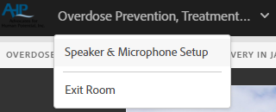

Audio Logistics
You will begin muted. To unmute and mute your line, dial *6 on your telephone or click the phone icon.
Improving Access to Behavioral
All participants should be connected by phone.
If you are not connected by phone, please type your direct number in the Tech Support box and we will call out to you.
Notes:
PRODUCER
This event is discussion based, so you will have opportunities to speak aloud. Use the raise hand button to request to come off mute during discussions. It looks like the picture you see on your screen. You’ll find it at the very top, above the slides. When you raise your hand, I will open your phone line for you if you’re on mute. Go ahead and cluck the raise hand button now so I know you’ve found it. Great! Now please click it again to lower your hand. Thanks!

Slide 5

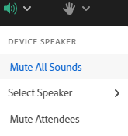

Audio Logistics
Today’s audio is best experienced via telephone, but you can use a computer microphone.
If you need help or would like the phone conference information, type in the ALL QUESTIONS box.
Use the Audio Setup Wizard or Speaker & Microphone Setup to change settings

Slide 6



Questions and Resources
Content questions and tech support requests go into the ALL QUESTIONS box.
Share resources and network with colleagues in the Public Chat.
Enlarge the screen with four outward facing arrows.

Slide 7
Bed registries have been around since 2006
Disclaimer
This webinar was developed [in part] under contract number HHSS2832012000211/HHSS28342003T from the Substance Abuse and Mental Health Services Administration (SAMHSA), U.S. Department of Health and Human Services (HHS). The views, policies and opinions expressed are those of the authors and do not necessarily reflect those of SAMHSA or HHS.

Slide 8
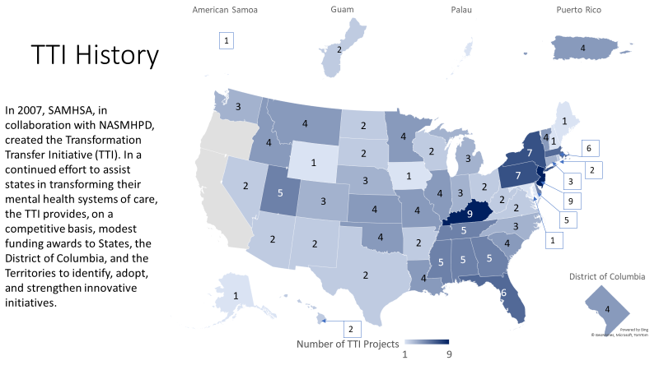
The Transformation Transfer Initiative
Notes:
These flexible TTI funds are used to strengthen transformation initiatives and activities that can be implemented in the State, either through a new initiative or expansion of one already underway, and focus on one or multiple phases of system change. TTI recipients are chosen on the following criteria:
Transformation readiness, demonstrated by examples of transformation initiatives already underway using State funds, Block grant funds, other identified public or private resources;
Existing multi-agency collaboration on transformation initiatives;
Proposed initiatives rooted in systems change with the greatest quality impact;
Identification of other state resources and infrastructure which may leverage the TTI award funds for the proposed initiative; and
Realistic timeframes, concrete activities, and measurable outcomes for the proposed initiative.

Slide 9
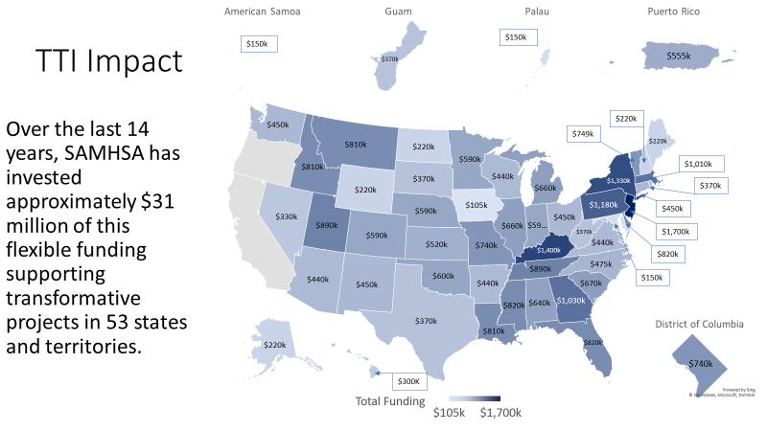

Slide 10
Bed registries have been around since 2006
23 TTI States = 23 different approaches
The problem(s) that states seek to solve with the bed registry
How website users and bed providers interact
The public and private facilities that participate
The types of beds listed
The frequency and method of updating bed availability
Who can access the bed registry
https://www.nasmhpd.org/content/tti-2019-bed-registry-project-fact-sheets-and-full-report
Notes:
Over the past 18 months, we’ve been talking to the 23 TTI states and visited many of them in person before COVID. The report details what we found. In today’s webinar, we will present what we heard from states particularly:
The initial problems they were trying to solve with bed registries.
Which facilities are providing the updates to the bed registry site
What information bed registries provide and how referral are made
The types of beds that are included in bed registries
How bed data is refreshed and
Who can access the bed registry

Slide 11
Bed registries have been around since 2006
What problem are you trying to solve and how could a bed registry help?
Getting people into care quickly
Reducing hospital emergency room waits
Support crisis response systems
Making better use of resources
Diverting admissions from state hospitals to community based short-term care
Making the system capacity and services transparent
Empowering consumers and providers
Mandates from executive or legislative
branches of state government
Notes:
What approach states take is always based on the problem they were trying to address. In some cases states were under an executive or legislative mandate that defined the purpose or vehicle of an electronic registry. But in every state, the primary goal has been to get people into care quickly. In addition to that, states had additional motivation; excessive waits in hospital emergency departments, lending supported and improving the efficiency of mobile crisis teams, and several saw the bed registry as a way to monitor how well policies were working to divert patients to community based short term settings like crisis stabilization units. Some states saw the bed registry as a way to make the system transparent to stakeholders and consumers and empower them.
The chart on the right illustrates the most common impact measures of the bed registries. These metrics reflect the problems states identified as their motivation to develop bed registries. Time to treatment is the most common issue followed by bed capacity and utilization. Closely tied to utilization is diversion to less used and costly alternatives

Slide 12
Bed registries have been around since 2006
Who are the potential stakeholders that should be involved in planning?
Notes:
Studies on bed registries have documented how important stakeholder engagement has been to successful bed registries. Without stakeholder buy-in, bed registries fail. If hospital staff don’t enter the data, the data become unreliable, and users don’t bother with the website. Many states pointed out that before the bed registry, crisis providers and emergency department staff already had a system to place individuals in beds and that it relied on personal relationships, negotiation, and persistence through phone calls and faxes. Bed registries are asking them to do something new and different. To some stakeholders, a bed registry can seem like another unnecessary layer of administrative burden in their way to getting patients into treatment – the exact opposite of what most states want bed registries to do. Successful state had to engage stakeholders in designing systems that add value and help them do their jobs. To find that out – states had to ask their stakeholders. This chart reflects the stakeholders most commonly engaged in planning the bed registry. Some are engaged in the foundation, some after the contract, and some consulted after the system is designed. In addition to engaging stakeholders, some states have incentivized or required participation through contracts. Hospitals were often the toughest stakeholders to persuade and it is reflected in state efforts to engage them. Some states established steering committees, some states added bed registries to existing planning committees, and some states used less structured means to solicit input.

Slide 13
Bed registries have been around since 2006
What types of facilities do you want to participate and how do you get them
on-board?
Notes:
There was a wide variety of bed types included in registries. The most common were crisis stabilization units. I grouped CSUs that were 23 hours or less with longer stay crisis stabilization units. Public psychiatric hospitals were slightly less likely to be included in the registries because access to them was limited or required multiple approvals in some states. As noted in the introduction, engaging private hospital systems in the registry has been challenging. Several states have used Medicaid and other service contracts with hospital systems to leverage their participation in the registries. Some state systems have limited registry listings to resources that they control either directly or through contracts, including hospital beds. More than half of the states include substance use disorder (SUD) settings in a unified bed registry. States that have a separate SUD bed registry are not included in this count. About one-third (8) of the state registries include beds for children and youth. About one-third (8) of states use the registry to track community residential beds to support transitions from hospitals to the community, freeing up hospital beds for those who need them. Four (4) states included crisis respite settings and one state includes facilities for specialized populations

Slide 14
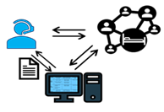
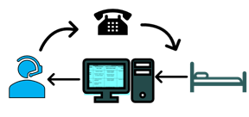

Bed registries have been around since 2006
What do you need/want the bed registry to be able to do?
Search Engines
Connecticut
Idaho
Massachusetts
Mississippi
New Jersey
New York
Rhode Island
Utah
Vermont
Oklahoma
            Alabama*
Florida*
Maryland*
West Virginia*
Referral Systems
Georgia
North Carolina
Tennessee
Referral Networks
Delaware
Indiana
Nebraska
Nevada
New Mexico
Ohio
* Projected
14
Notes:
Based on the problems that states sought to solve and the input of stakeholders (or not), state bed registries websites support the interaction of users and bed providers in three ways.
I’ll go over these in more detail, but basically, search engines provide information on bed availability and contact information and they were the most common approach. Referral systems support users to make referrals electronically. Referral networks support users and providers to make referrals to each other.

Slide 15
Bed registries have been around since 2006
What data do you want to collect from bed registries?
Notes:
The truth is, we don’t have any hard evidence that bed registries hasten access to care or improve the type of care people receive. No state has done a before/after comparison and only the referral systems and referral networks are able to collect data on the time it takes from referral to treatment. During implementation, states are appropriately measuring compliance with daily bed counts.
But here’s what these states are actively or planning to measure:
Search Engines with real time, 12, or 24 hour bed updates can tell you state bed capacity at any given time, which providers admit more patients, regional gaps in services, and surges and lulls in demand. By comparing daily volume across bed types, states can see trends in the use of CSUs, hospital beds, respites, and public hospitals to establish resources where they are most needed, or implement policies and procedures to divert patients from state hospital admissions to CSUs. When this data is combined with other sources, like hospital emergency department waits, states can see whether CSUs and other resources are being efficiently and fully utilized.
Referral systems and networks have the added benefit of collecting referrals (demand) and time and distance to obtain treatment. When triangulated with other data sources, hospital boarding for example, state policy makers can begin to see when and where people are helped to stabilize their conditions or conversely, how treatment is delayed or denied and by whom. While they can’t tell us whether finding a bed is faster with a bed registry, they can help us to make finding a bed faster.
And for states with an integrated continuum of care, bed registries should help providers direct patients to the right setting rather than the only one they know.

Slide 16
For additional information, please contact:
Ted Lutterman, NRI
ted.lutterman@nri-inc.org
703-738-8164
NASMHPD Staff
Leah Holmes-Bonilla
leah.holmes-bonilla@nasmhpd.org
David Miller
david.miller@nasmhpd.org
David Morrisette
david.morrisette55@gmail.com
https://www.nasmhpd.org/content/tti-2019-bed-registry-project-fact-sheets-and-full-report

