Slide 1
Washington Update: What Does the Election mean for Entitlement Reform?
NASDDDS and NASMHPD
Legal Divisions Joint Meeting 2012
November 13-14, 2012
Dan Berland
Director of Federal Policy
NASDDDS

Slide 2
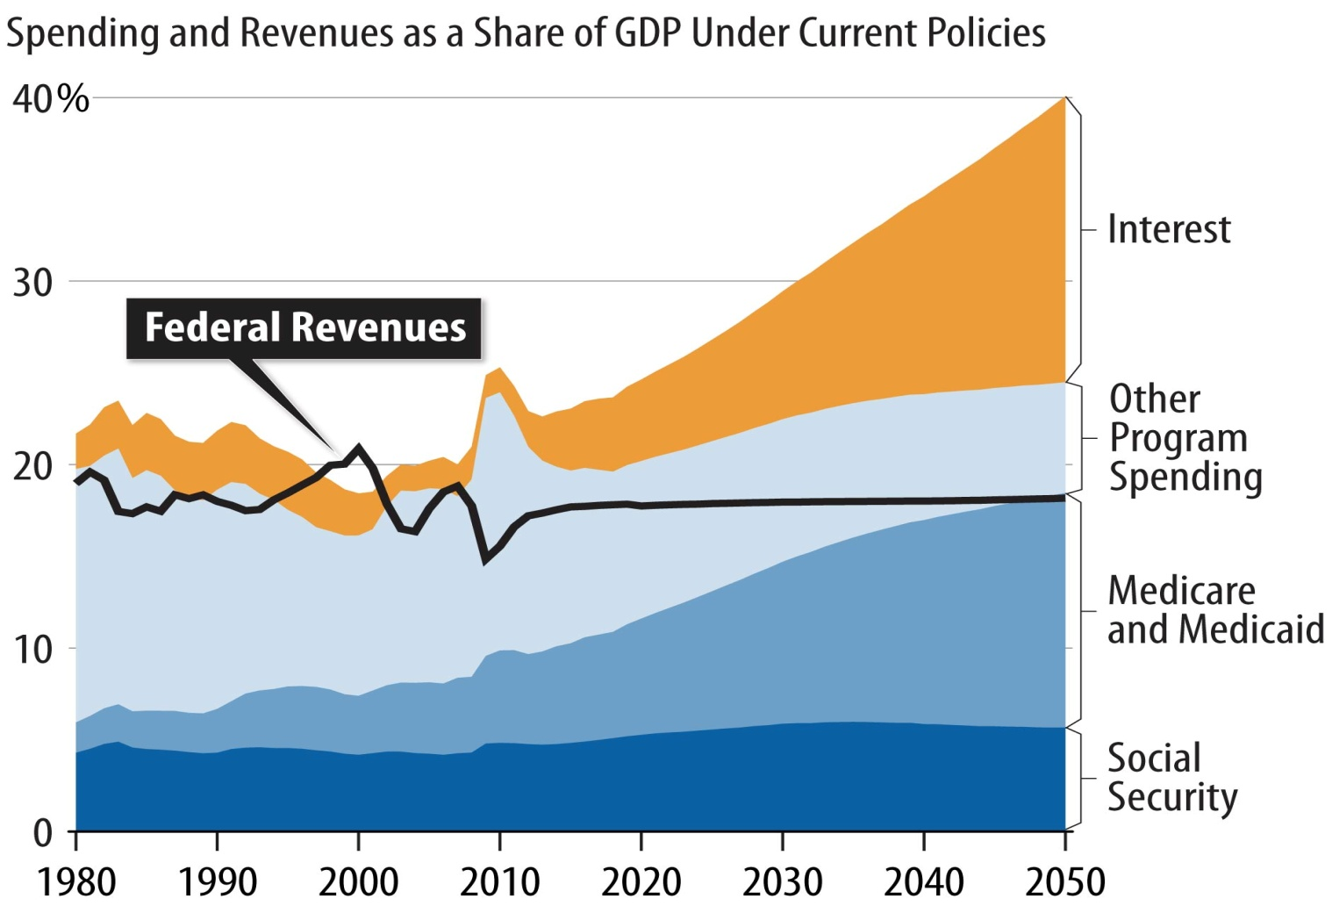
Current Policies Are Not Fiscally Sustainable: Change is Coming
Source: CBPP projections based on CBO data.

Slide 3
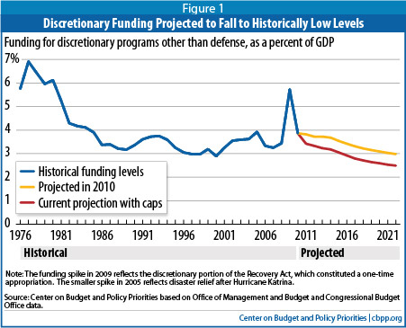
Actions to Decrease the Deficit Have Already Been Passed
Spring 2011
$1.5 trillion reductions in discretionary programs cut funding for 2011 below 2010 inflation adjusted levels – reducing the base for future years.
Aug. 2011
Reduced future-year funding with the BCA caps on discretionary funding.
Figures do not include sequestration.
NASDDDS National Association of State Directors of Developmental Disabilities Services
Notes:
The $1.5 trillion in budget reductions in discretionary programs that policymakers have enacted reflect two actions that policymakers took last year. First, in the spring of 2011, Congress and the President cut discretionary funding for fiscal year 2011 below the 2010 inflation-adjusted level, and thereby reduced the base on which discretionary funding levels for future years are built. Second, in August 2011, they reduced future-year funding substantially by enacting the BCA, which established statutory caps on total discretionary funding and separate “sub-caps” on funding for defense and non-defense (i.e., domestic and international) discretionary programs for 2012 through 2021.[1] (Note: the Budget Control Act also required across-the-board budget cuts, called sequestration, if the Joint Select Committee on Deficit Reduction, otherwise known as the “super committee,” failed. The $1.5 trillion in budget reductions discussed here do not include the additional budget cuts that will be made if sequestration takes place.)
Under the BCA caps, non-defense discretionary funding will, by 2022, be 15 percent below the 2010 level adjusted for inflation. Defense funding will be about 10.5 percent below that level. See Table 1, below.

Slide 4
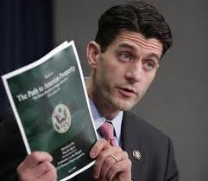
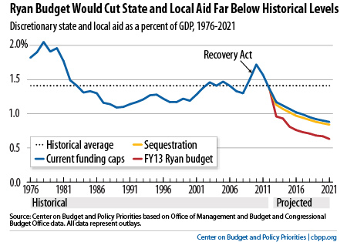
Ryan Plan
Replaces Medicaid with a block grant
Grows each year with inflation and U.S. population growth but at more than 3.5 percentage points less than current projected annual growth in Medicaid.
States get expansive new flexibility in areas such as eligibility and benefits. States could cap enrollment, charge significant premiums, offer vouchers to purchase private insurance, and cut some currently
required services
CBO has estimated that by 2050, combined
federal funding for Medicaid, CHIP, and
federal subsidies provided through ACA
would be cut by more than 75 percent
NASDDDS National Association of State Directors of Developmental Disabilities Services

Slide 5
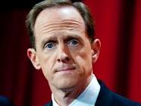
Toomey Plan
Similar block grant structure to
Ryan proposal
Reduces Medicaid by about $990 billion over the next ten years — $180 billion more than under the Ryan budget
NASDDDS National Association of State Directors of Developmental Disabilities Services

Slide 6
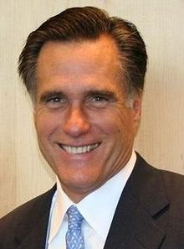
Governor Romney’s Plan
Cap total spending: “Reduce federal spending to 20 percent of GDP by the end of my first term” and “cap it at that level.”
Increase defense spending: “[Set] core defense spending — meaning funds devoted to the fundamental military components of personnel, operations and maintenance, procurement, and research and development — at a floor of 4 percent of GDP.” These categories encompass 93 percent of the national defense budget function.
Repeal the Affordable Care Act: “Work with Congress to repeal the full legislation as quickly as possible.”
Governor Mitt Romney’s proposals to cap total federal spending at 20 percent of gross domestic product (GDP) and boost defense spending to 4 percent of GDP would require very large cuts in other programs, both entitlements and discretionary programs.
NASDDDS National Association of State Directors of Developmental Disabilities Services

Slide 7
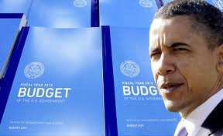
President’s Proposal
Cuts more than $50 billion from Medicaid
$17 billion over 10 years by establishing a “blended rate” for Medicaid and CHIP in 2017
Blends FMAP, CHIP match, and Medicaid expansion match into one number, and reduces it by as much as 5 percent.
Would increase automatically if an economic downturn forced enrollment to rise and state costs to increase
NASDDDS National Association of State Directors of Developmental Disabilities Services

Slide 8
Fiscal Cliff
Tax Relief, Unemployment Insurance Reauthorization, and Job Creation Act of 2010 (extended the Bush Tax Cuts);
Budget Control Act of 2011 ("sequestration“--automatic spending cuts worth $1.2 trillion over a decade)
Reversion of the Alternative Minimum Tax thresholds to their 2000 tax year levels;
Middle Class Tax Relief and Job Creation Act of 2012 (MCTRJCA) (“doc fix,” 2% Social Security payroll tax cut, federal unemployment benefit extension)
New taxes imposed by the Patient Protection and Affordable Care Act and the Health Care and Education Reconciliation Act of 2010.

Slide 9
Post-Election: Boehner
Wednesday--Said he was ready to accept a budget deal that raises federal revenue as long as it is linked to an overhaul of entitlements and a reform of the tax code that closes loopholes, curtails or eliminates deductions and lowers income tax rates.
Friday—Said raising taxes was off the table and claimed a mandate: “The American people re-elected a Republican majority, and I’m proud of the fact that our team in a very difficult year was able to maintain our majority.”

Slide 10
Post-Election: Obama
Friday—Obama: “I just want to point out this was a central question during the election…And on Tuesday night, we found out that the majority of Americans agree with my approach.” Says he’s willing to make some concessions as long as the final fiscal bargain was properly balanced between new tax revenue and spending cuts.
NYT—”House Republican leadership aides found some positive signals in Mr. Obama’s combative tone. They noted that he never specified he wants tax rates to rise, only that he wants additional revenues generated by taxes on the rich. That would give both sides the latitude to devise a restructured tax code that eliminates or limits tax deductions and credits for the rich.”

Slide 11
Does Entitlement Reform Equal Opportunity?
Democrats will want cuts to do the least harm
Many Republicans who support block grants may wish to protect vulnerable populations
Discussions about removing LTSS from Medicaid
Medicare Part E for Seniors
Title 22 of the SSA for People with Disabilities

Slide 12
Medicare Part E
Mandatory
Paid for by actuarially determined premiums starting at age 65
No more dual eligibles

Slide 13
Title 22
Details are undetermined
Maintain federal/state partnership
Cross disability
Not means-tested?
Purpose beyond care?
Entitlement to community
Blend in other programs beyond Medicaid?

Slide 14
Contact Me
Daniel M. Berland
Director of Federal Policy
NASDDDS
Tel (Mon., Wed., Fri.): 703-683-4202
Tel (Tues., Thurs.): 410-730-6610
E-mail: dberland@nasddds.org

